Slide 1
An Introduction to RFgen Mobile Foundations for Deltek Costpoint
Presented by:
Sales Consultant

Slide 2
Agenda
What are the Challenges?
RFgen Software Overview
[Prospect Name]’s Business Challenge
RFgen Mobile Foundations for Deltek Costpoint
What You Can Do With RFgen
Deltek Costpoint Customer Success Stories
Q&A

Slide 3
8 Challenges Solved with a Mobile Data Collection Solution
Growing Business
Margin Pressure
Government Regulations
Value from IT
Traceability
Accuracy
Scalability
Customer Service
Notes:
Growing Business
Your business is growing and needs to increase throughput to keep from having to develop or purchase more facilities.
Margin Pressure
Margin pressure from competitive market forces and increased costs is causing pressures to look for savings throughout the business.
Government Regulations
Faced with changing and expanding regulatory requirements, you need to ensure compliance with ePedigree requirements, maintain tracking of lot/batch/country of origin, comply with FDA Bioterrorism Act requirements and more.
Value from IT
You want to get more output from you existing IT infrastructure – without putting day-to-day operations at risk.
Traceability
You are being asked to support the Produce Traceability Initiative (PTI) to ensure complete produce traceability and support GS1 standards.
Accuracy
Providing more “perfect orders” is a top objective in enhancing customer service. To achieve this, you need to offer solutions for improving shipment accuracy and timeliness of delivery.
Scalability
You’re evaluating processes to keep pace with the growth of your online business and find a solution to address the line item order fulfillment business amid a changing mix of product shipments.
Customer Service
Your business continues to look for ways to provide competitive differentiators and customer service offerings.

Slide 4

Paper-Based and Manual Processes Create Inefficiencies

Slide 5

It also Makes it Difficult to Get Real-Time Visibility into Inventory

Slide 6
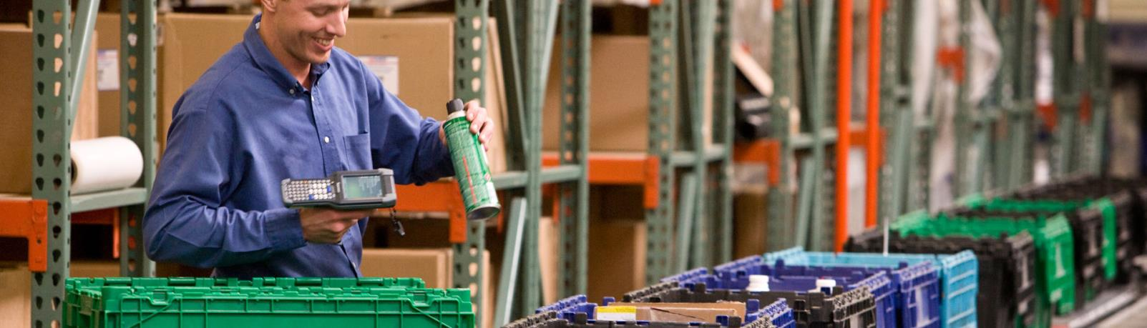
What You Need are Barcode and Mobile Solutions to Track Inventory in Real-Time

Slide 7
RFgen Software Overview

Slide 8

Who is RFgen Software?
Established in 1983
Deltek-Validated Integration
Global Reach
Costpoint 7.0
2,800 worldwide installations
140 partners worldwide
Regional support in 35+ countries
Total Solution Provider
Certified Partner
Software
Hardware
Professional Services
Oracle Gold Partner
Deltek Premier Partner
SAP Partner

Slide 9
RFgen Mobilizes the Supply Chain
Integrated ERP Solutions
SAP
Supply Chain Accelerators
And More
Industry Solutions
Aerospace & Defense
SAP Business One
And More
Warehouse Automation
Voice Picking
Remote Warehouse Automation
Feed, Food & Beverage
Life Sciences
Oil & Gas
Retail
CPG
Engineering, Construction & Industrial Supplies
High Technology
Industrial Machinery & Equipment
And More
Asset Management
Barcode Labeling
Inventory Management
Field Service
License Plating
Oracle E-Business Suite
JD Edwards
Deltek Costpoint
Shop Floor Data Collection

Slide 10



The RFgen Mobile Framework
RFgen Software designs, implements and deploys mobile and wireless software, and open source supply chain solutions for automated data collection.
Barcoding
Voice
Roaming
Mobile

Slide 11
RFgen is Not a WMS
WMS
Typically a combination of a desktop and handheld application.
A separate system with its own separate database.
Requires data synchronization between the ERP and WMS, which requires some management because you have two separate databases.
RFgen
An add-on mobile data collection software solution to Costpoint.
Does not require a separate database because it processes transactions in real-time against Costpoint.
A system that extends the functionality of Costpoint onto a mobile device.
Typically has its own set of business rules and configuration that must be set up and managed.
A solution that utilizes the data and business rules already setup in Costpoint.

Slide 12
Where is RFgen Used?
Inside the Four Walls
Outside the Four Walls
Inventory Management
Warehouse Automation
Voice-Directed Operations
Manufacturing Operations
Field Service
Freight Yard Operations
Remote Inventory Management
Direct Store Deliver
Transportation and Logistics
Track and Trace

Slide 13







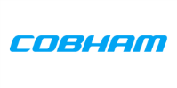















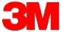

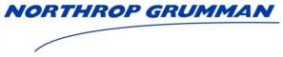






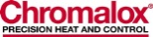




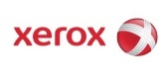















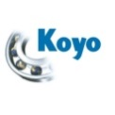











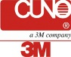











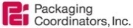















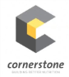










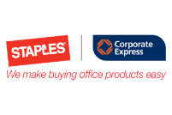
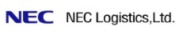









2,800+ Sites | 25+ Industries | 35+ Countries
Aerospace & Defense
Automotive
Consumer Packaged Goods
Electronics
Engineering & Construction
Feed, Food & Beverage
High Technology
Industrial Machine & Equipment
Life Sciences
Manufacturing
Oil & Gas
Pharmaceutical
Retail
Transportation & Logistics
Utilities & Energy

Slide 14
RFgen Mobile Foundations For Deltek Costpoint

Slide 15
RFgen Mobile Foundations for Deltek Costpoint
Mobile Application Development Platform
Tightly Integrated with Deltek Costpoint
Out-of-the-Box Pre-Written Pre-Tested Mobile Apps
Architecture Facilitates Rapid Modification and Configuration
Supports Multiple Data Capture Scenarios for Real-time, Mobile and Batch Workflows

Slide 16


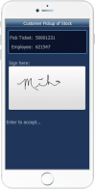
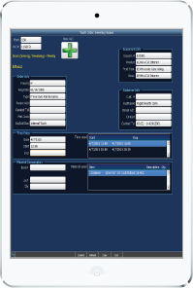

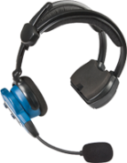
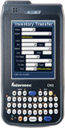
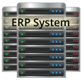
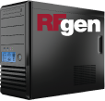

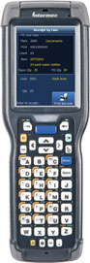
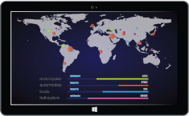
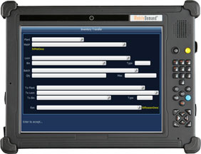
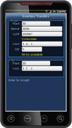
RFgen-Costpoint Integration
Devices
Business Logic Integration
Costpoint Web Services
Data Integration
Business Data
Configuration Options
Real-Time Data Validation

Slide 17
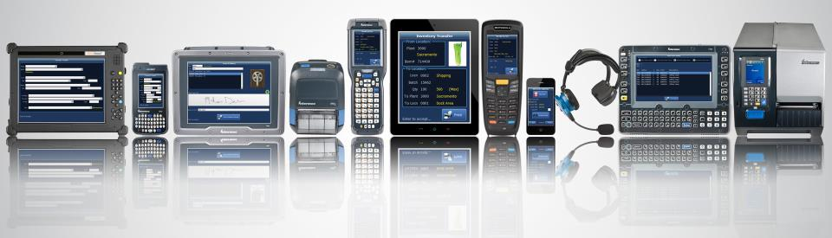
RFgen Extends Costpoint to Any Data Collection Device Type
Operating Systems
Windows Mobile and CE
Android
iOS
Telnet
Data Collection Devices
Barcode Scanners
Tablets and Smartphones
Vehicle Mount Computers
Voice Recognition
RFID
And More
Machine-to-Machine (M2M)
Carousels and Scales
Sensors
Meters
Robots
And more
Notes:
RFgen can not only work with Android and iOS devices, but we also work with older technologies using Windows Mobile, Windows CE, and Telnet.
We haven’t run into any device RFgen couldn’t run on, but if we do we will get that device running at no charge.

Slide 18
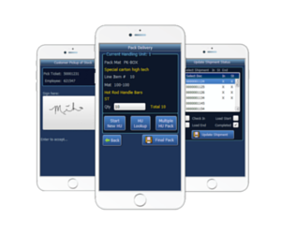
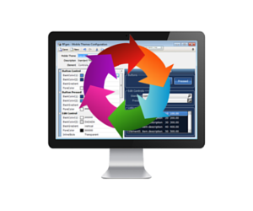
RFgen Framework for Costpoint
Pre-Built Mobile Application Suite
Certified and pre-tested mobile applications
RFgen Mobile Development Studio
Drag and drop visual environment
Integrate with other shop floor systems
Change pre-built mobile apps or build new ones
Implement out of the box or customize
Built using data collection best practices

Slide 19
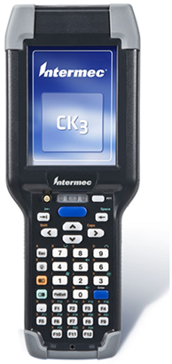
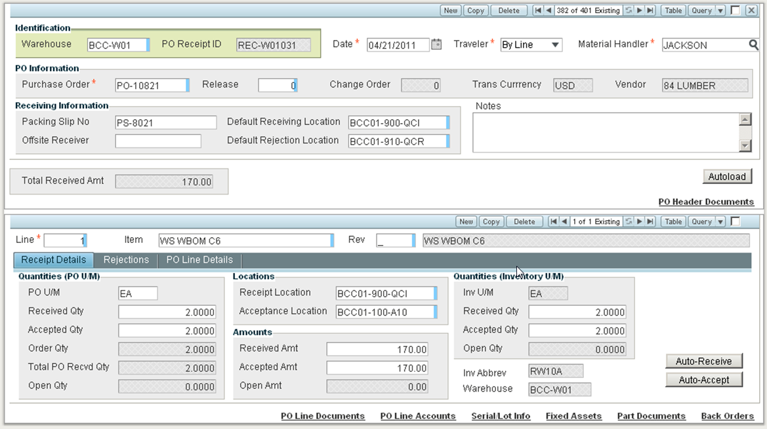
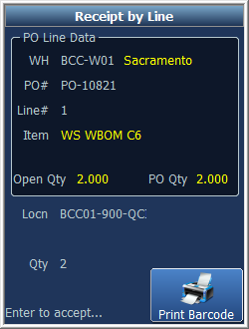
RFgen-Costpoint Integration
RFgen on a Mobile Device
Costpoint Screen
All data is validated against business data in Costpoint.
All transactions are executed using Costpoint web services.
Notes:
Jeff

Slide 20
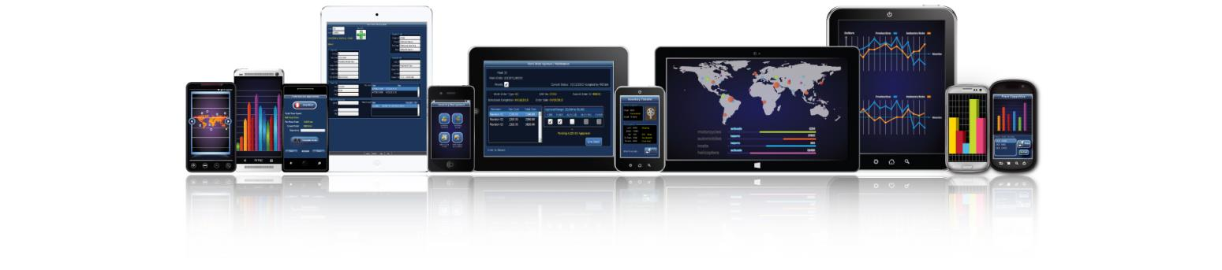
Pre-Built Costpoint Mobile Apps Included
CUSTOMIZE AND CREATE YOUR OWN MOBILE APPS!
Inventory Management
Actual Counts
Adjustments
Location Transfers
Inventory Transfers
Issue to POs
Issue to Projects
Issue to Sales Orders
View Inventory
PO Processing
PO Receipts
Quality Control Inspections
Manufacturing
Issue to Manufacturing Orders
Manufacturing Orders Reliefs

Slide 21
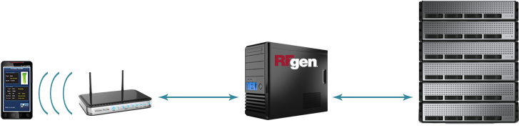
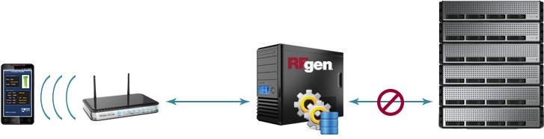

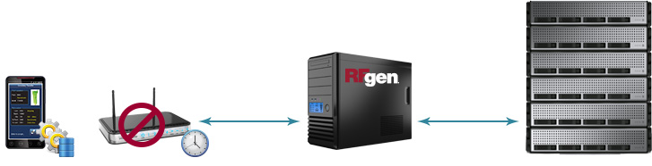
RFgen Connectivity Scenarios
Real-Time
High Availability
Offline Mobility

Slide 22
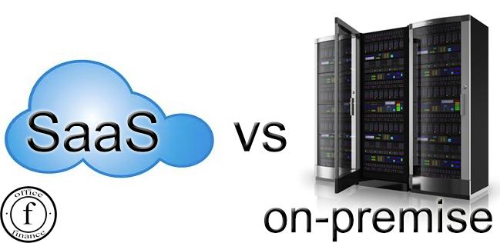
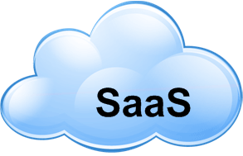
Deployment Options
Onsite use license
Eliminates privacy and security concerns
No capital expenditure
Annual payments
Minimizes internal IT requirements to deploy and manage
Run RFgen in your IT infrastructure
Maintain complete control of your entire RFgen platform
Manage complex data, analytics, or big data sets including networks, analysis, image services, or real-time sensor streams

Slide 23

RFgen Implements in Weeks, Not Months
Open Source Code Samples
Rapid Application Development Platform
No Cryptic Scripting Language
Uses Data Dictionary Aliases
Reusable Objects
Interactive Debugger
Built-in SQL Testing
Deploys Instantly to All Devices
Notes:
RFgen is simple to implement. Typical implementation time is 4-6 weeks.

Slide 24
What You Can Do With RFgen

Slide 25
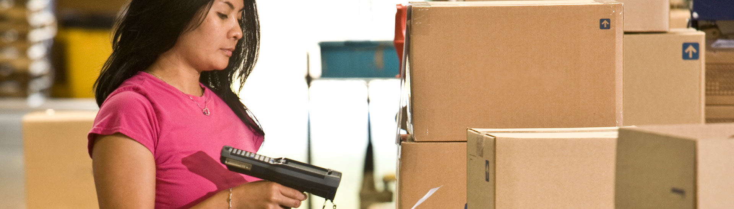
RFgen provides real-time, wireless connectivity to a wide range of systems and supports numerous warehouse operations like:
Inventory management
Receiving
Picking, packing and shipping
Manufacturing
Quality assurance
Time and attendance
Wireless and Mobile Data Collection

Slide 26

RFgen supports mobile on-demand access to your data from any Windows, Android or iOS device.
Vendor managed inventory
Product returns
Drop ship
Proof of delivery
Direct store delivery (DSD)
Field service/sales
Batch (fields, yards, freezers, etc.)
On-Demand Mobile Enterprise Connectivity

Slide 27
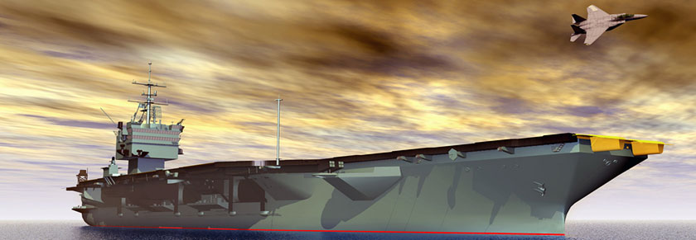
RFgen provides the ability to continue operating 24/7, even when the host system is unavailable.
Remote and off-shore locations
Poor/occasional connectivity
Disconnected environments
Nightly/weekly back-ups
100% transaction visibility
High Availability Disconnected Solutions

Slide 28
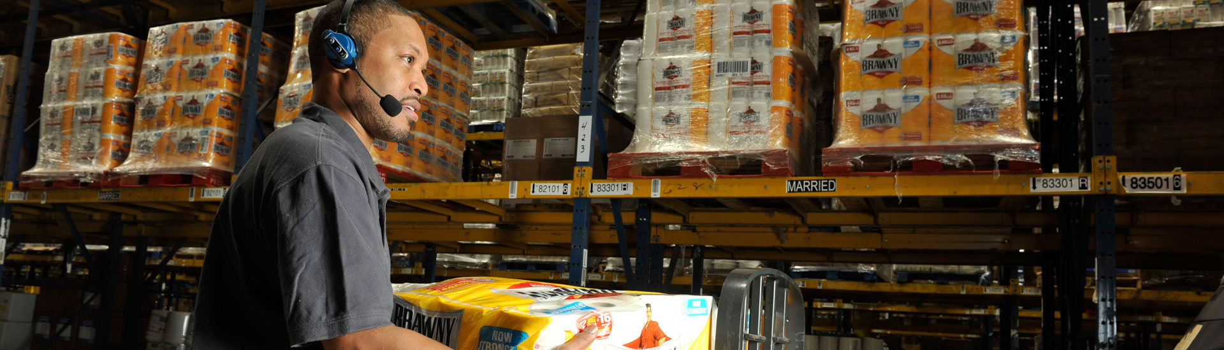
Hands-Free, Eyes-Free Warehouse Operations
The RFgen-Vocollect Voice Solution provides hands-free, eyes-free warehouse operations, helping you achieve:
10-25+% productivity gains
Up to 99.99% accuracy
Improved safety
Increased job satisfaction
Reduced training costs

Slide 29
Deltek Costpoint Customer Success Stories

Slide 30

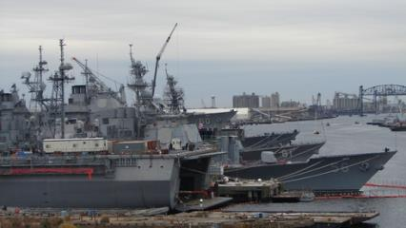
Company:
Industry:
Application:
Environment:
BAE Systems Ship Repair
Aerospace & Defense
Inventory Control, Receiving, Offline Mobility
Deltek Costpoint 7.0.1
The RFgen Solution:
Enhanced inventory control and purchase order processing workflows for improved accuracy and efficiency.
Standardized processes across various companies.
Mobilized transaction processing for mobile data collection in the shipyard.
BAE Systems is a global defense, security and aerospace company that delivers a full range of products and services for air, land and naval forces, as well as advanced electronics, security, information technology solutions.
Notes:
BAE Systems Ship Repair currently operates Deltek Costpoint 6.1 and is upgrading to Costpoint 7. The goal is to enhance the operations by implementing Advanced Data Collection (ADC) in Inventory and Purchasing for improved inventory metrics.
The RFgen Deltek Integration Suite contains a number of transactions that are not within the scope of this project. These additional transactions will be made available to BAE Systems as part of the RFgen Deltek Open Source suite. These template transactions may be modified or utilized as needed by BAE Systems Ship Repair.

Slide 31

Company:
Industry:
Application:
Environment:
CyberCore Technologies
High Technology
Inventory Management and Receiving
Deltek Costpoint 7.0.1
The RFgen Solution:
450% increase receiving speed with fewer employees.
99.999% accuracy in receiving and inventory management, with no customer rejections.
Improved the process for inventory counts to get more accurate counts and location information
CyberCore Technologies provides managed services including IT asset procurement, problem resolution and Tier-3 support for defense, aerospace and domestic security agencies.

Slide 32

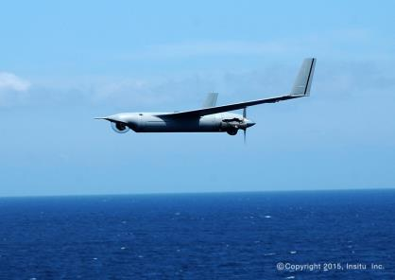
Company:
Industry:
Application:
Environment:
Insitu Inc.
UAV Systems
Inventory Management and Custom Applications
Deltek Costpoint 7.0.1
The RFgen Solution:
Improved inventory control for more efficient movement of materials and parts.
Mobilized data collection to replace manual warehouse processes with automation.
Saved labor by reducing trips through the warehouse to fulfill manufacturing orders.
Insitu is a pioneer leader in the design, development, production and operation of high-performance, cost-effective unmanned aircraft systems (UAS).
Notes:
BAE Systems Ship Repair currently operates Deltek Costpoint 6.1 and is upgrading to Costpoint 7. The goal is to enhance the operations by implementing Advanced Data Collection (ADC) in Inventory and Purchasing for improved inventory metrics.
The RFgen Deltek Integration Suite contains a number of transactions that are not within the scope of this project. These additional transactions will be made available to BAE Systems as part of the RFgen Deltek Open Source suite. These template transactions may be modified or utilized as needed by BAE Systems Ship Repair.

Slide 33
RFgen is a Total Solutions Provider
RFgen
Software
Hardware
Professional Services
Support
Deltek-validated integration with Costpoint
Suite of pre-built mobile apps
Mobile development studio for fast and easy application development
24/7 technical phone support
24/7 online support and resources
Classroom and online training
Certified reseller of major mobile device and hardware brands
Windows, Apple iOS and Android
Single vendor accountability
ERP integration expertise
Mobility and automation expertise
Supply chain and industry expertise

Slide 34
How [Prospect] Wins with RFgen
A solution for right now
Implement a Deltek-validated solution for Costpoint that will meet your organizations exact needs for automated data capture today.
A solution that will evolve with you
Integrate multiple (disparate) systems and multiple ERP systems.
Integrate with third-party inventory management solutions.
Integrate with multi-carrier shipping and automated equipment.
Add new workflows, new product lines and new facilities.
Achieve a low total cost of ownership and quick ROI.
Administer one single-source platform for all your mobility and automation needs.
Manage and maintain one platform with minimal effort.
Easily upgrade your front-end systems when you upgrade your Costpoint system.
A solution that provides value

Slide 35
Questions?
Contact
call | TBD
email | TBD
visit | TBD

Slide 36
Other Slides

Slide 37
The Advantages of Automation
Mobile Data Validation and Processing Against Costpoint
Multiple options to meet your requirements:
Endless Mobile Worker Possibilities
Proof of delivery signature capture
Direct connect
Connect-on-demand
Batch on- and off-line (hybrid solutions)
Mobile field service
Sales order creation
Asset tracking/warranty tracking
Automation of Warehouse Activities
Eliminates manual processes
Increases data accuracy
Increases employee productivity
Real-time data validation and processing
Notes:
If you have a mobile workforce, RFgen’s mobile data validation and processing against JD Edwards gives you multiple options to meet your requirements including:
Direct connect, where you have a direct connection to your RFgen server via a 3G/4G device or smart phone.
Connect on demand, which allows you to collect transactions in a disconnected mode and then send those transactions to the RFgen server at your convenience.
Batch on and offline, which is a hybrid of direct connect and connect on demand.
There are endless mobile worker possibilities. Things like:
Proof of delivery signature capture, where you might have your own delivery fleet.
Mobile field service that allows you to track your parts inventory and transact against repair or service orders.
Sales order creation and customer service applications for your mobile sales force.
Asset tracking and warranty tracking for assets that may be in offsite locations.

Slide 38
Mobile Data Collection by the Numbers
Faster Training
Increase in Productivity
Increase in Efficiency
Increase in Accuracy
99%
25%
30%
80%

Slide 39

RFgen’s Costpoint Consulting Team Core Competencies
Senior level consulting expertise in business processes for Costpoint.
Extensive knowledge of industry-specific best practices for automated data capture and warehouse management solutions.
Real-world, hands-on experience with multiple data capture technologies and process workflows.
Ability to plan, prepare, design, and deploy solutions that deliver desired results.

Slide 40

Around the Clock Technical Support
RFgen technical support experts are on-hand 24 hours a day, seven days a week.
Toll-free number gives you instant access to an RFgen technical expert, ready to help you get your applications back up and running.
For non-urgent issues, submit an online help request or search the RFgen Online Knowledgebase.
Join the RFgen LinkedIn User Community and gain access to others using RFgen.

Slide 41
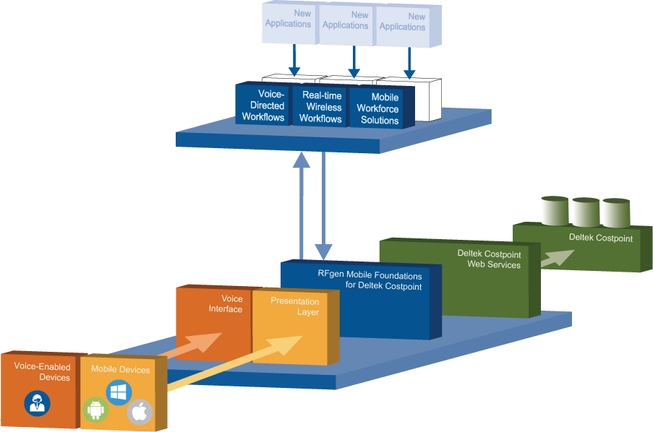
RFgen System Architecture

Slide 42
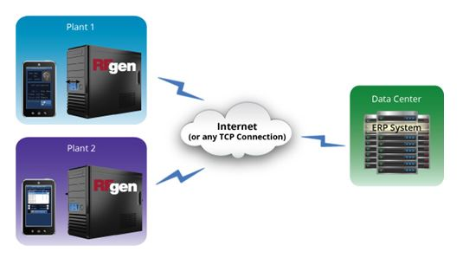
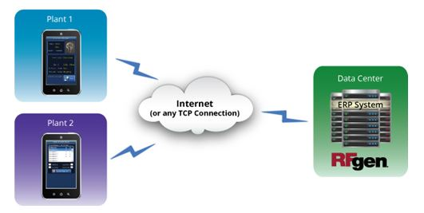
RFgen Architecture On-Premise
RFgen On-Premise
Scenario 1
RFgen On-Premise
Scenario 2

Slide 43
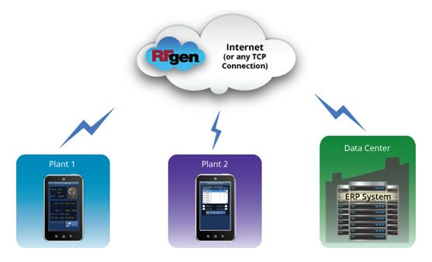
RFgen Architecture In the Cloud
RFgen in the Cloud

Slide 44
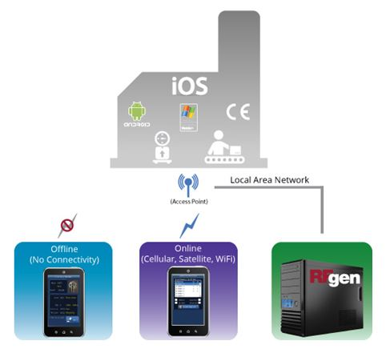
RFgen Connectivity Scenarios
RFgen in or Near the Plant

Slide 45
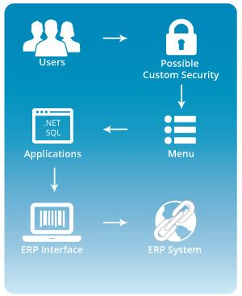
RFgen Application Framework

Slide 46
[Prospect Name]’s Business Challenge

Slide 47

[Prospect Name]’s Business Challenge
Briefly describe the prospect’s business challenge
Text
Text
Text

Slide 48

[Prospect Name]’s Expected Project Deliverables
Briefly outline what they hope to get by automating
Text
Text
Text

Slide 49



[Prospect Name]’s Requirements
Requirement | RFgen Meets Requirement
Text
Text
Text

Slide 50

How will RFgen Meet all of Your Requirements?
The flexibility and robustness of the RFgen Mobile Framework enables us to meet all of [Prospect Name]’s requirement for warehouse automation and mobility.
Let’s take a look at RFgen Mobile Foundations for Deltek Costpoint.

Slide 51
Summary of Your RFgen Project
Turn-key solution for warehouse automation for the workflows listed to the right.
Meets the unique or specific requirements of each of the four distribution centers.
If there are other areas where efficiencies can be created we can incorporate them into this project very easily.
This solution can provide a mobile field sales application for your 250+ field reps.
Create increased efficiency / throughput
Reduction of direct labor
Increased inventory accuracy
eliminate manual processes and data entry
RFgen is very flexible and scalable
Transactions Includes in RFgen Solution
RFgen Distribution Suite
Cycle Count
PO Receipt by PO/Line
RFgen Warehouse Management
Warehouse Director
Put Away by Item
RFgen License Plate Suite
Create Entity
Assign Entity
Create LP Type
Create Plate
Attach Plate
Detach Item
Transfer LP
Pick, Pack, Ship (Outbound)
Pick to Plate
Ship Confirm Plate / Load
RFgen Inquiries
Item/Location Inquiry
Location Inquiry
Supply/Demand Inquiry
PO Inquiry by Item / Line

